Slide 1
Map Reduce And Data Parallelism

Slide 2

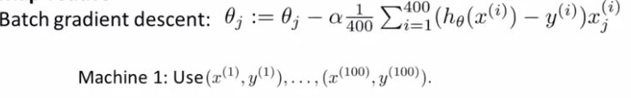




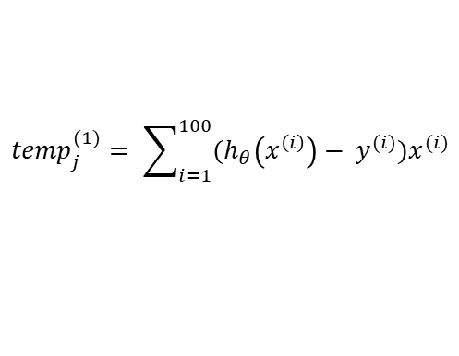
Map reduce
$${temp}_{j}^{(1)}= \sum_{i=1}^{100}{(h_{θ}\left(x^{\left(i\right)}\right)− y^{(i)})x^{(i)}}$$
$∇ ={temp}_{j}^{(1)}$ + ${temp}_{j}^{(2)}$ + ${temp}_{j}^{(3)}$ + ${temp}_{j}^{(4)}$

Slide 3
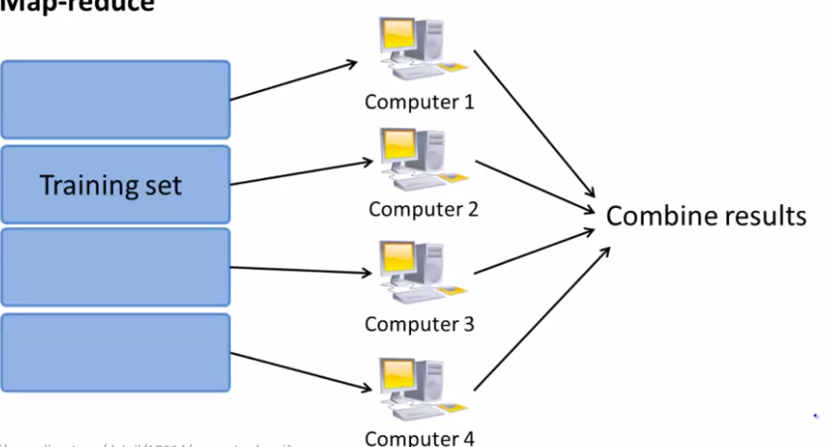
Map Reduce

Slide 4
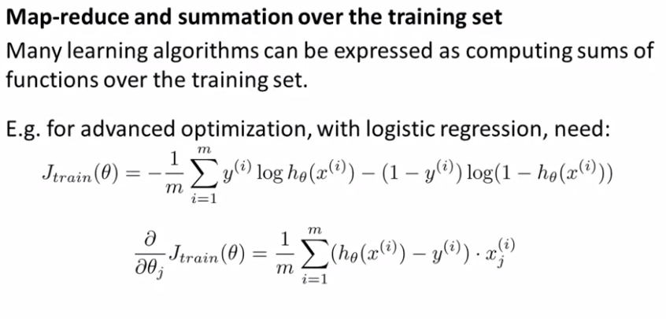
Map Reduce

Slide 5
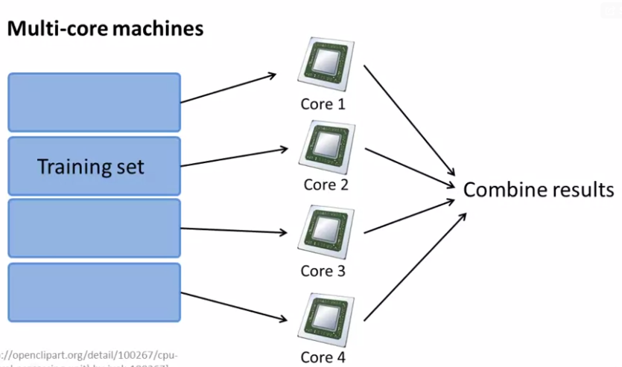

Map Reduce

